Slide 1
Unveiling the Untapped Potential of Zero-shot Text Classification
Project Progress Presentation
SUSHANT RAJ – 200953062
Computer and Communication Engineering
Under the guidance of
Internal Guide
Dr. Girija Attigeri
Associate Professor
Information and Communication Technology
May 20, 2024
1/ 4

Slide 2
Presentation Outline
1
Introduction
Literature Survey / Background Theory Problem Definition
Objectives Methodology
Results
Real life Application
SDG
Scope
Conclusion
References
2
3
4
5
6
7
8
9
10
2/ 4

Slide 3

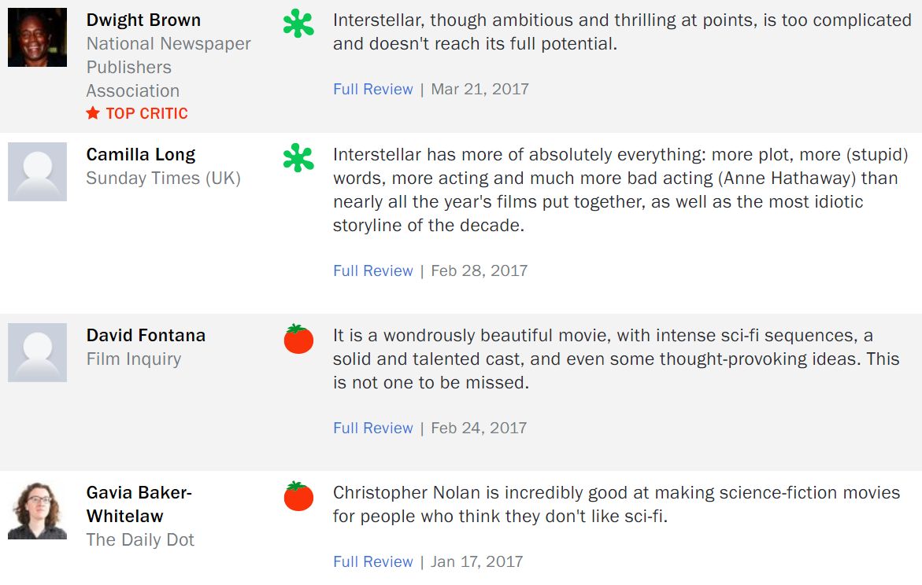
Introduction
Interstellar Movie Reviews from Rotten Tomatoes
Notes:
Whenever we want to watch a new movie, I am sure all of us first check on reviews both from audiences and critics to decide whether to watch the movie or not. User reviews are valuable not only for guiding movie choices but also for informing decisions across a wide range of fields such as product purchases, restaurant selections, travel accommodations, service providers, healthcare options, education choices, technology adoption, book reading preferences, hotel stays, and event attendance. These user reviews not only help the customers or other users but also provide invaluable insights and feedback for businesses and organizations, guiding them in improving their products, services, and customer experiences.

Slide 4

Apple’s MacBook Pro – Redesigned Keyboard
MacBook Pro models (2016-2019) featured a butterfly keyboard mechanism.
Users reported keys sticking, being unresponsive, leading to frustration.
Apple redesigned the keyboard with a scissor mechanism for 2020 models.
"Magic Keyboard" design improved reliability and typing experience.
This demonstrates Apple's commitment to addressing user feedback.
Notes:
One specific example of Apple improving a product based on user feedback is the MacBook Pro with the redesigned keyboard.
The MacBook Pro models released from 2016 to 2019 featured a "butterfly" keyboard mechanism, which received significant criticism from users due to issues such as keys sticking or becoming unresponsive. Users reported frustration with the typing experience and concerns about the durability and reliability of the keyboards.
In response to this feedback, Apple redesigned the keyboard mechanism for its MacBook Pro models released in 2020. The new keyboard, known as the "Magic Keyboard," replaced the butterfly mechanism with a scissor mechanism that was more reminiscent of earlier MacBook keyboards. The redesign addressed many of the issues users had experienced with the previous keyboard, leading to improved reliability and a better typing experience.
This example demonstrates how Apple listened to user feedback and made significant changes to improve the quality and usability of its products.

Slide 5
Introduction
Limitations of Conventional NLP Text Classification Methods:
Requires large amount of labelled data for effective training.
Struggles to adapt to new categories.
Need frequent retraining as new data becomes available.
Zero-Shot Text Classification
Machine learning approach for identifying unseen objects or classes.
ZSTC doesn't require labelled examples for every class.
Utilizes additional information like word embeddings to learn about unseen classes.
Focus on understanding the context of the data, not just the data itself.
Notes:
Domain-Specific Language:
Different domains (e.g., product reviews vs. movie reviews) use unique language, slang, and jargon. A model trained on product reviews may not understand specific phrases or terminology used in movie reviews.
Context and Sentiment Expression:
Sentiment expression can vary by context. For example, a word that is positive in one context (e.g., "cheap" for products) might be negative in another (e.g., "cheap" for movies). Labeled examples help the model learn these nuances.

Slide 6
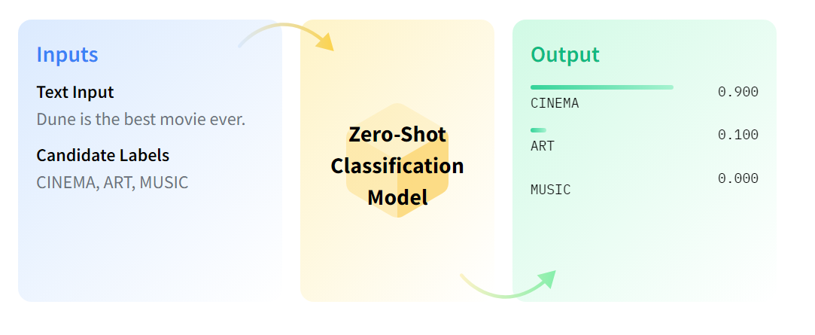
Zero-shot text classification allows models trained on certain topics, to categorize new topics, using auxiliary information.
These models can make predictions for unseen topics without requiring specific training data for those topics.
The project focuses on zero-shot text classification with the Transformers library, employing pre-trained models like BART trained on datasets like MultiNLI.

Slide 7
Background Theory
Transformers library by Hugging Face offers a wide array of pre-trained models and NLP tools.
It is designed to work seamlessly with TensorFlow and PyTorch, making it accessible for NLP tasks.
The library features popular transformer-based models like BERT, GPT, and BART.
These models are pre-trained on extensive text data and can be fine-tuned for specific NLP applications such as text classification and sentiment analysis.

Slide 8
Background Theory
BART (Bidirectional and Auto-Regressive Transformers)
Transformer model developed by Facebook AI.
Combines aspects of both BERT and GPT, thus making it versatile for NLP tasks like text generation and comprehension.
BART Large
Larger version of the BART model.
More parameters than the BART model – allows it to capture more complex patterns and perform on a wide range of tasks.

Slide 9
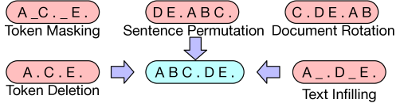
BART is pre-trained on a large and diverse text corpus, mainly the Common Crawl dataset, which includes a wide variety of text from the web such as articles, blog posts, and forums.
This pre-training helps BART develop a strong understanding of diverse language uses and contexts.
BART is trained as a denoising autoencoder. The pre-training involves corrupting the input text in various ways and then training the model to reconstruct the original text. The corruption strategies include:
Notes:
1. Token Masking
Description: Randomly masks (replaces with a special token) some tokens in the input sequence.
Purpose: Forces the model to predict the masked tokens, encouraging it to learn contextual relationships and dependencies between words.
Example:
Original: "The quick brown fox jumps over the lazy dog."
Masked: "The [MASK] brown [MASK] jumps over the lazy dog."
2. Token Deletion
Description: Randomly deletes some tokens from the input sequence.
Purpose: Forces the model to understand the context and meaning of the sentence even with missing information.
Example:
Original: "The quick brown fox jumps over the lazy dog."
Deleted: "The quick fox jumps over the lazy dog."
3. Text Infilling
Description: Replaces spans of text with a single mask token.
Purpose: Encourages the model to predict multiple masked tokens within a context, improving its ability to understand and generate coherent text.
Example:
Original: "The quick brown fox jumps over the lazy dog."
Infilling: "The [MASK] jumps over the lazy dog."
4. Sentence Permutation
Description: Shuffles the order of sentences in the input sequence.
Purpose: Helps the model understand the relationship between sentences and the overall context of the text.
Example:
Original: "The quick brown fox. Jumps over the lazy dog."
Permutation: "Jumps over the lazy dog. The quick brown fox."
Application in Denoising Autoencoder
These techniques are used during the pre-training phase of models like BART to create a corrupted version of the input text.
The model is then trained to reconstruct the original text, helping it learn robust representations and contextual understanding.

Slide 10
FACEBOOK/BART-LARGE-MNLI-MODEL
It is a version of the BART model that has been specifically fine-tuned on the MNLI dataset.
MNLI dataset contains around 433,000 sentence pairs and includes text from a variety of genres, such as fiction, letters, telephone speech, government reports, and more. This diversity helps models generalize better across different types of text.
Fine-tuning a model like BART on the MNLI dataset teaches it to understand and infer relationships between different pieces of text. This is crucial for tasks where the model needs to generalize to new, unseen categories.

Slide 11
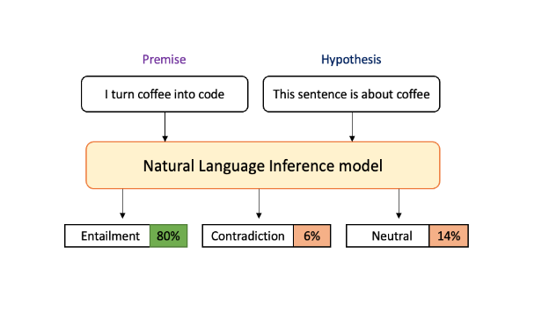
Premise: A statement or piece of text.
Hypothesis: Another statement that is being tested against the premise.
Labels: Entailment, contradiction, neutral
Entailment: The hypothesis logically follows from the premise.
Contradiction: The hypothesis contradicts the premise.
Neutral: The hypothesis is neither entailed nor contradicted by the premise.

Slide 12
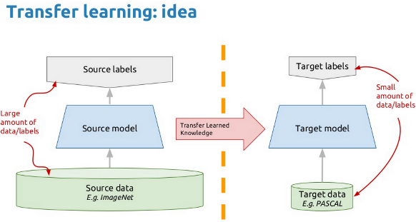
TRANSFER LEARNING
The knowledge learned from the MNLI dataset during fine-tuning is transferred to the zero-shot text classification task.
This enables the model to apply its understanding to new topics and make accurate predictions without needing specific training data for those topics.

Slide 13
ZERO SHOT TEXT CLASSIFICATION
This is achieved by treating the class labels as hypotheses and the input text as premises.
The model uses its understanding of semantic relationships learned during fine-tuning on MNLI to deduce the most likely class label for the input text.

Slide 14
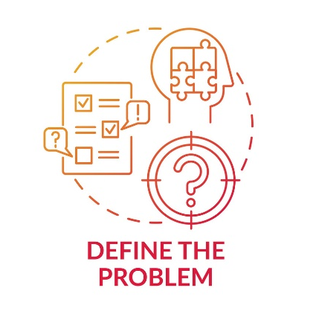
Problem Definition
Zero-shot text classification seeks to address the challenge of classifying text into predefined classes without the need for explicit training on those classes. This method is beneficial in scenarios where acquiring labelled data for all categories is unfeasible or challenging.

Slide 15

Objectives
Implement Zero-Shot Learning (ZSL) and traditional text classification methods (Naive Bayes, SVM, RNN) on multiple datasets of varying sizes.
Inspect the performance of each text classification technique using metrics like accuracy, F1-score, precision and recall, to identify the most effective method.
Compare the effectiveness of ZSL and other traditional text classification methods across datasets, analyzing their generalizability and robustness.
Visualize the results using bar graphs to offer a precise analogy of the performance of different classification methods.

Slide 16
Methodology
Dataset Acquisition: For our zero-shot learning (ZSL) project implementation, we've acquired three distinct datasets. The Amazon Review dataset, offers diverse product reviews for sentiment analysis. The Twitter Sentiment Prediction dataset consists of tweets labeled with sentiment, ideal for ZSL tasks. Lastly, the Restaurant Food Review dataset, provides user-generated reviews on food quality and service, enriching our sentiment analysis and ZSL endeavors.
Model Selection: The facebook/bart-large-mnli model, a variant of BART is fine-tuned on the MNLI dataset, for zero-shot text classification. This model understands semantic relationships between sentences, crucial for tasks like natural language inference (NLI).
Zero Shot Text Classification: Employ the model to categorize review texts as 'positive' or 'negative' without explicit training on these classes. By considering review text as a premise and class labels as hypotheses, the model deduces the most likely label based on semantic similarity learned from the MNLI dataset.

Slide 17
Zero Shot Implementation
Load the dataset into a DataFrame.
Initialize a zero-shot classification pipeline with the bart-large-mnli model.
Define candidate labels ('positive', 'negative’).
For each review text, apply the zero-shot classification pipeline to predict the label and score.
Convert predicted and ground truth labels to numerical format.
Calculate evaluation metrics (accuracy, F1 score, precision, recall).
Display predicted labels, confidence scores, and evaluation metrics.

Slide 18
Naive Bayes Classifier Implementation
Text undergoes pre-processing including tokenization, lowercasing, and lemmatization.
Sentiment labels are encoded as 0 for 'negative' and 1 for 'positive’.
Text is converted into numerical features using TF-IDF vectorization.
Multinomial Naive Bayes classifier is trained on the TF-IDF transformed data to learn probability distributions for each word with respect to sentiment labels.
Classifier calculates likelihood of each sentiment label for input text and selects label with highest probability.
Model performance is evaluated using metrics like accuracy, precision, recall, and F1-score, comparing predicted labels to actual labels in the datasets.

Slide 19
SVM Implementation
Each word in the input text is treated as a feature, mapping the text data into a high-dimensional space.
SVM identifies the best hyperplane to separate the text into distinct classes, maximizing the margin between the hyperplane and support vectors.
Utilizes a linear kernel to create a linear decision boundary for class separation.
The SVM model is trained on TF-IDF converted training data, representing each input text as a vector of TF-IDF scores.
After training, the SVM model predicts labels for test data, and metrics such as accuracy are computed to analyze its performance.

Slide 20
RNN Implementation
GRU variant of RNN is employed .
Preprocess text data by tokenizing and converting it to numerical format.
Build an RNN model with layers like embedding, recurrent, and dense layers, then compile it with a Binary Cross Entropy loss function and Adam optimizer.
Train the model on labelled data, evaluate its performance, and make predictions on new test data for classification tasks.

Slide 21
Results
DATASET 1 (Amazon Reviews – Sentiment Prediction)
 | ZSL | Naive Bayes | SVM | RNN
Accuracy | 0.92 | 0.83 | 0.87 | 0.86
F1 Score | 0.91 | 0.83 | 0.87 | 0.85
Precision | 0.95 | 0.83 | 0.87 | 0.86
Recall | 0.88 | 0.83 | 0.87 | 0.84

Slide 22
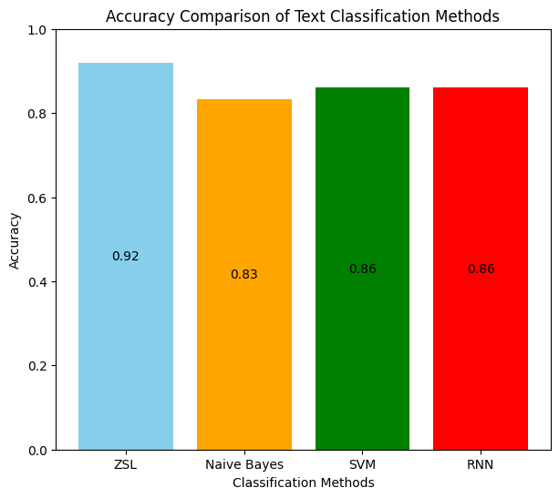
Results
Accuracy Bar Graph Plot of ZSL vs Supervised Text Classification Methods for Amazon Product Review Dataset

Slide 23
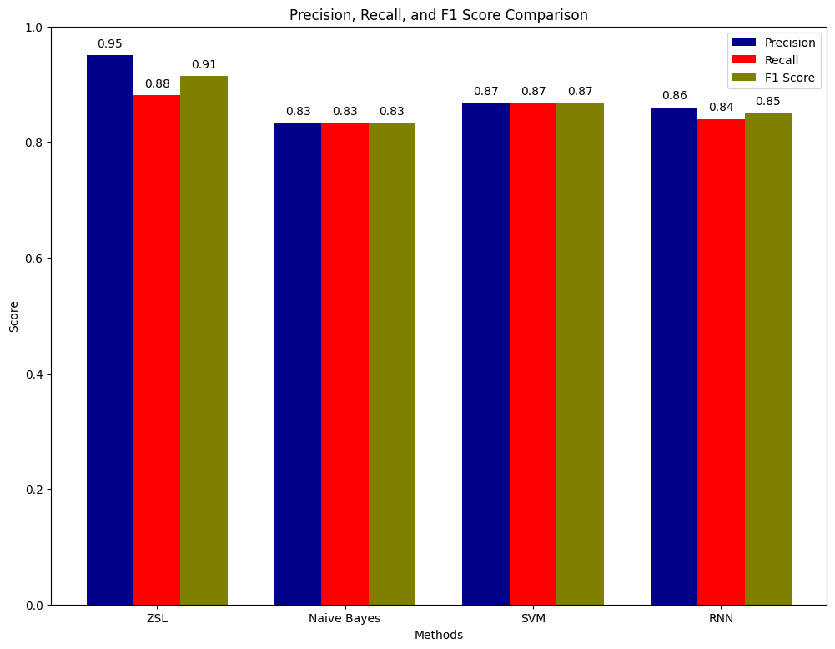
Results
Precision, Recall and F1-Score Bar Graph Plot of ZSL vs Supervised Text Classification Methods for Amazon Product Reviews Dataset

Slide 24
Results
Zero-Shot Learning (ZSL) achieves the highest accuracy of 92% compared to Naive Bayes, SVM, and RNN in text classification tasks.
Naive Bayes shows lower performance of 83% which may be due to its assumption of independence among features, which may not hold true for review text.
SVM and RNN perform similarly, with SVM slightly outperforming RNN in terms of accuracy, precision, and recall.
ZSL's ability to generalize well across diverse and undefined classes makes it particularly well-suited for datasets like Amazon Reviews.

Slide 25
Results
DATASET 2 ( Twitter Data – Sentiment Prediction)
.
 | ZSL | Naive Bayes | SVM | RNN
Accuracy | 0.93 | 0.89 | 0.89 | 0.87
F1 Score | 0.90 | 0.89 | 0.89 | 0.75
Precision | 0.84 | 0.89 | 0.89 | 0.80
Recall | 0.97 | 0.89 | 0.89 | 0.71

Slide 26
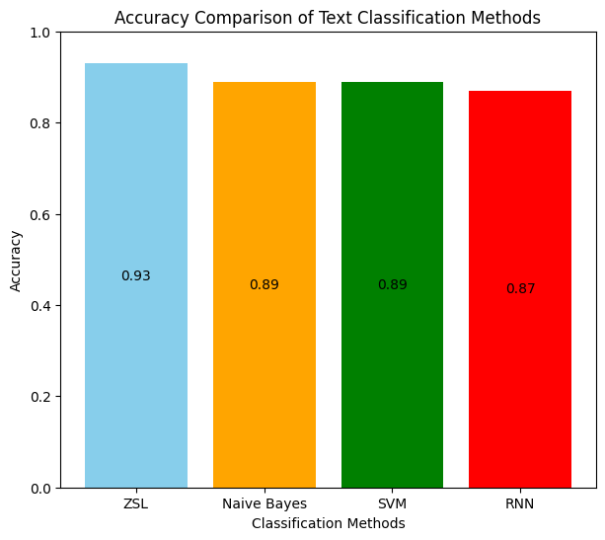
Results
Accuracy Bar Graph Plot of ZSL vs Supervised Text Classification Methods for Twitter Sentiment Dataset

Slide 27
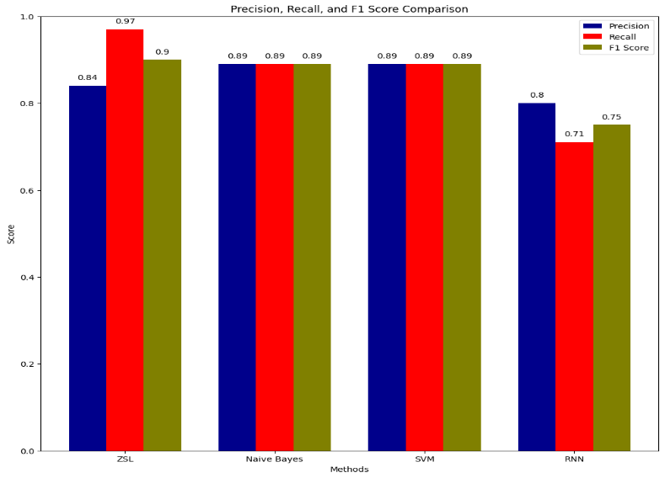
Results
Precision, Recall and F1-Score Bar Graph Plot of ZSL vs Supervised Text Classification Methods for Twitter Sentiment Dataset

Slide 28
Results
Zero-Shot Learning (ZSL) achieves the highest accuracy of 93%, showcasing its effectiveness in making accurate predictions.
Naive Bayes and SVM exhibit similar performance across accuracy, precision, and recall, indicating their effectiveness in classifying sentiment in brief texts.
Recurrent Neural Network (RNN) demonstrates a slightly lower accuracy among the models, with the lowest F1 score, precision, and recall. This may be due to the decreased dataset size.
Overall, ZSL, Naive Bayes, and SVM are effective approaches for sentiment analysis on the Twitter Sentiment dataset, with ZSL excelling in capturing relevant instances.

Slide 29
Results
DATASET 3 (Restaurant Food Reviews – Sentiment Prediction)
 | ZSL | Naive Bayes | SVM | RNN
Accuracy | 0.98 | 0.83 | 0.79 | 0.78
F1 Score | 0.98 | 0.82 | 0.79 | 0.77
Precision | 0.97 | 0.83 | 0.80 | 0.78
Recall | 0.98 | 0.81 | 0.79 | 0.80

Slide 30
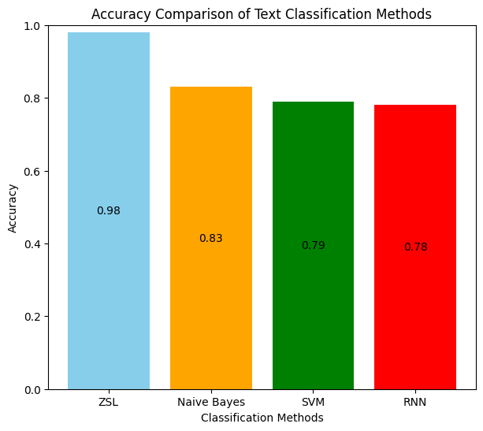
Results
Accuracy Bar Graph Plot of ZSL vs Supervised Text Classification Methods for Restaurant Reviews Dataset

Slide 31
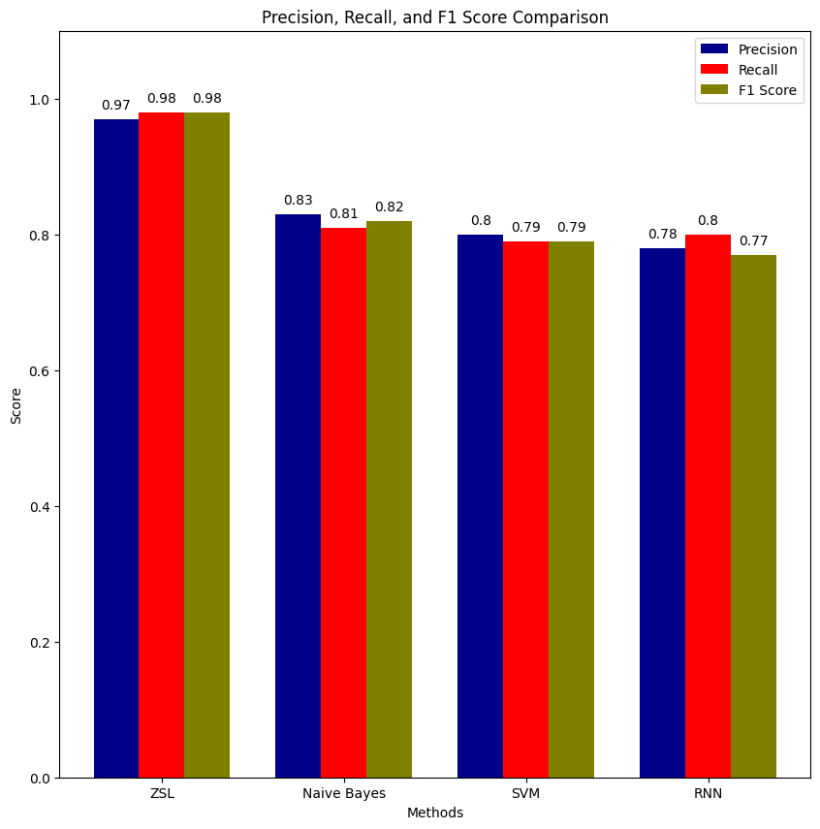
Results
Precision, Recall and F1-Score Bar Graph Plot of ZSL vs Supervised Text Classification Methods for Restaurant Reviews Dataset

Slide 32
Results
Zero-Shot Learning (ZSL) demonstrates superior accuracy of 98% and across all metrics compared to Naive Bayes, SVM, and RNN.
Despite the small dataset size, ZSL accurately classifies reviews, highlighting its potential for efficient and accurate text classification tasks even with brief textual data and a small dataset.
Naive Bayes’s slightly lower accuracy may be due to its assumption of feature independence, which may not capture complex linguistic patterns and context dependencies in natural language.
SVM fails to fully capture the features from TF-IDF vectorization, resulting in lower performance compared to ZSL.
RNN demonstrates low performance due to the small training dataset, leading to fewer examples to learn from and potential overfitting, affecting generalization to unseen data.

Slide 33
Real Life Application of Zero Shot Text Classification
Analyzing user comments and posts on social media platforms to evaluate public opinion about products, services, or events.
Automatically categorizing customer feedback into positive and negative sentiments to identify areas for improvement.
Analyzing product reviews to understand customer satisfaction levels and make informed decisions about product improvements.
Analyzing textual data from surveys, interviews, or focus groups to understand consumer preferences and market trends.
Notes:
We have adopted zero-shot text classification predominantly for its application in sentiment analysis. This approach enables us to analyze text data without the need for pre-defined categories, allowing for a more flexible and efficient sentiment analysis process. By focusing on sentiment analysis, we aim to leverage the efficiency of zero-shot text classification to gain deeper insights into customer perceptions, identify emerging trends, and drive proactive actions to optimize customer satisfaction and brand reputation.

Slide 34
Sustainable Development Goals
SDG 3 – Good Health and Well-Being
Data can be sourced from social media posts, news articles, surveys, or public health reports. These sources contain a variety of opinions and discussions about healthcare initiatives and access to quality healthcare. Zero-shot text classification is applied to categorize the collected texts into positive and negative sentiments. The model does this without being explicitly trained on examples from the healthcare domain, relying on its pre-trained understanding of language and sentiment.
SDG 8 – Decent Work and Economic Growth
Textual data can be collected from social media posts, news articles, economic reports, and surveys. These texts may contain opinions, feedback, or discussions related to job creation, unemployment, and job insecurity. The analysis provides insights into public sentiment towards job creation, unemployment, and job insecurity, highlighting areas of concern and potential actions to improve job market conditions. For example, if there are many negative sentiments regarding job insecurity, policymakers and employers may consider measures to enhance job security and stability.

Slide 35
Scope
Advances NLP research and education
Enhances marketing and customer service analytics
Automates sentiment analysis for improved productivity
Aids governments in public feedback analysis and policymaking
Provides insights for non-profits on social issues
Enables personalized content and better decision-making

Slide 36
Future Work
Apply the zero-shot text classification model to datasets with more than just binary labels, such as datasets with multiple sentiments or to categorize text into different labels.
To investigate the speed and computation time of our models to optimize their efficiency, potentially by leveraging parallel processing or other optimization techniques.
Integrate zero-shot and few-shot learning paradigms could further enhance performance across tasks with varying data availability.

Slide 37
Conclusion
Our exploration of zero-shot text classification using the facebook/bart-large-MNLI model demonstrates its potential to revolutionize how we approach NLP tasks.
By leveraging transfer learning and pre-trained models, we can achieve remarkable results even in scenarios with limited labelled data.
This opensup new possibilities for efficient text classification across various domains, paving the way for more accessible and impactful NLP applications.

Slide 38
Reference
[1] Sivarajkumar, S., & Wang, Y. (2023). Evaluation of Healthprompt for zero-shot clinical text classification. [Paper presented at the International Conference on Intelligent Computing and Health (ICICH), pp. 1-6].
[2] Basu, S., Campbell, R. H., & Karahalios, K. (2023). Detection of novel COVID-19 variants with zero-shot learning. [Paper presented at the International Conference on Intelligent Computing and Health (ICICH), pp. 1-6].
[3] Dan et al. (2022). Enhancing class understanding via prompt-tuning for zero-shot text classification. [Paper presented at the International Conference on Signal Processing (ICASP), pp. 1-5].
[4] Patadia et al. (2023). Zero-shot approach for news and scholarly article classification.
[5] Chong, W. J., Chua, H. N., & Gan, M. F. (2022). Comparing zero-shot text classification and rule-based matching in identifying cyberbullying behaviors on social media. In Proceedings of the 2022 IEEE International Conference on Artificial Intelligence in Engineering and Technology (IICAIET), pp. 1-5. [DOI 10.1109/IICAIET55139.2022.99369]

Slide 39
[6] Wang, Y., Wang, W., Chen, Q., Huang, K., Nguyen, A., & De, S. (2022). Generalised Zero-shot Learning for Entailment-based Text Classification with External Knowledge.
[7] Li, J., Chen, Q., Wang, W., & Wu, F. (2023). Knowledge-embedded Prompt Learning for Zero-shot Social Media Text Classification.
[8] Palaniappan, M., Vedhamani, A., & Sundharakumar, K. B. (2023). Zero-Shot Learning for Text Classification: Extending Classifiability Beyond Conventional Techniques.
[9] Kasthuriarachchy, B., Chetty, M., Shatte, A., & Walls, D. (2023). Cost Effective Annotation Framework Using Zero-Shot Text Classification.
[10] Zhang, Y., Yuan, C., & Wang, X. (2023). Generalized Zero-Shot Text Classification via Inter-Class Relationship. Beijing University of Posts and Telecommunications, Beijing, China.

Slide 40
Thank You
40/ 4

